Slide 1

OLIST STORE ANALYSIS
Mentor : Dipti Sinha
Group no : 4
Group Members :-
Pratiksha Manwatkar
Nithyasri Jain
Niraj Kumar

Slide 2
Project Objective
The Olist Store Analysis Project aims to analyse customer purchasing patterns and payment statistics an E – commerce platform, Olist. This project covers several key performance indicators (KPIs) such as weekday vs weekend sales, payment statistics, delivery time and customer behaviour. The analysis is based on nine CSV files, which are cleaned and manipulated to extract valuable insights.

Slide 3
KPI’S
Weekdays and weekend payment statistics
Number of orders with review score 5 and payment type as credit card
Average number of days taken for order-delivered-customer-date for pet-shop
Average price and payment value from customer for Sao Paulo city
Relationship between shipping days vs review scores

Slide 4
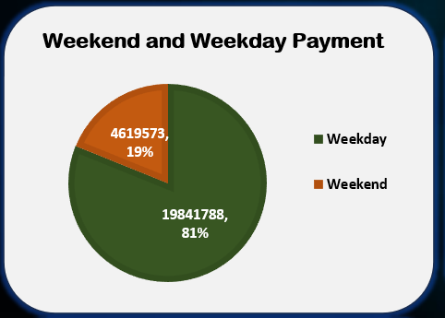
Kpi - 1
Weekday Vs Weekend (order-purchase-timestamp) Payment Statistics
The analysis of payment statistics based on weekday vs weekend provides and understanding of the buying behaviour of customers.
This KPI answers questions like, which of the week has the highest sales ? How many customers prefer to pay through online modes ?
The analysis of this KPI can help olist to improve their weekend sales and plan promotions accordingly.

Slide 5
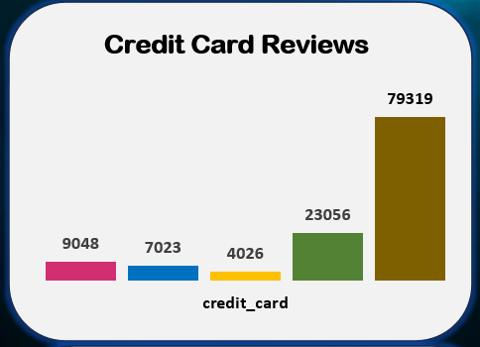
Kpi - 2
Number of Orders with Review score as 5 And payment type as Credit card
This KPI analysis the number of orders with a review score 5 and payment type as credit card. This help in understanding customers satisfaction levels and payment preferences. Olist can use this information to identify satisfied customers and encourage them to make repeat purchases.

Slide 6
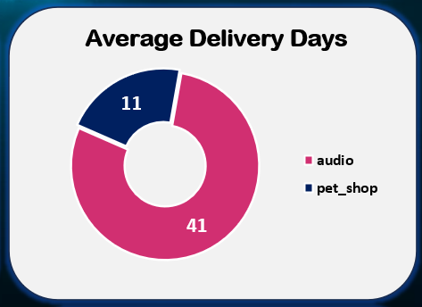
Kpi - 3
Average number of days taken for order-delivered-customer-date for pet-shop
This KPI analysis the average number of days taken for order delivered customer date for pet shop helps Olist in identify area where they can improve their delivery time and maintain customer satisfaction.

Slide 7
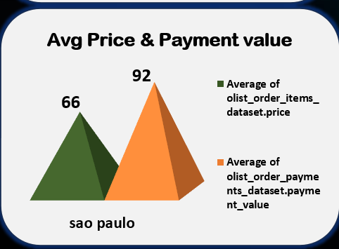
Kpi - 4
Average price and payment values from customers of Sao Paulo city
The analysis of average price and payment values from customers of Sao Paulo city help in understanding the spending pattern of customers in this region. It also help Olist in identifying high-value customers and creating targeted marketing campaigns.

Slide 8
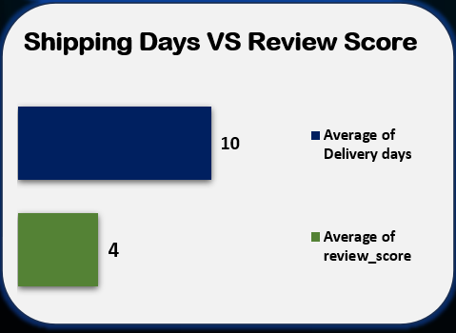
Kpi - 5
Relationship between shipping days (order delivered customer date –order purchase timestamp) Vs review scores
This KPI analysis the relationship between shipping days review scores. It helps in understanding the impact of delivery time on customer satisfaction levels. Olist can use this information to optimize their logistics and improve their delivery time.

Slide 9
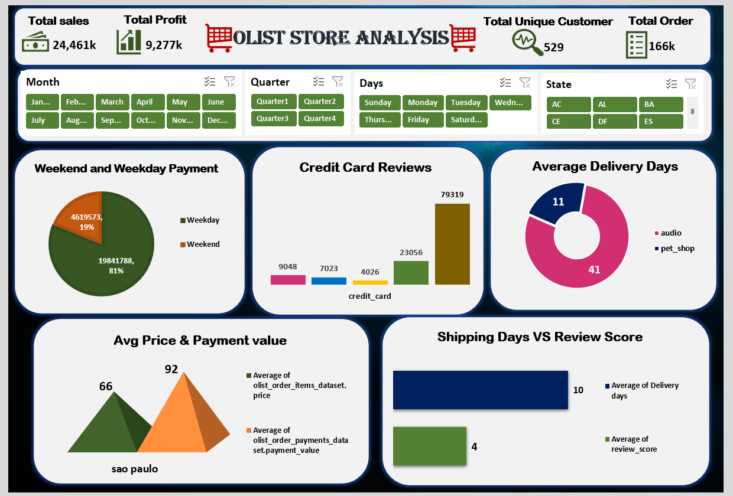
Olist excel dashboard

Slide 10
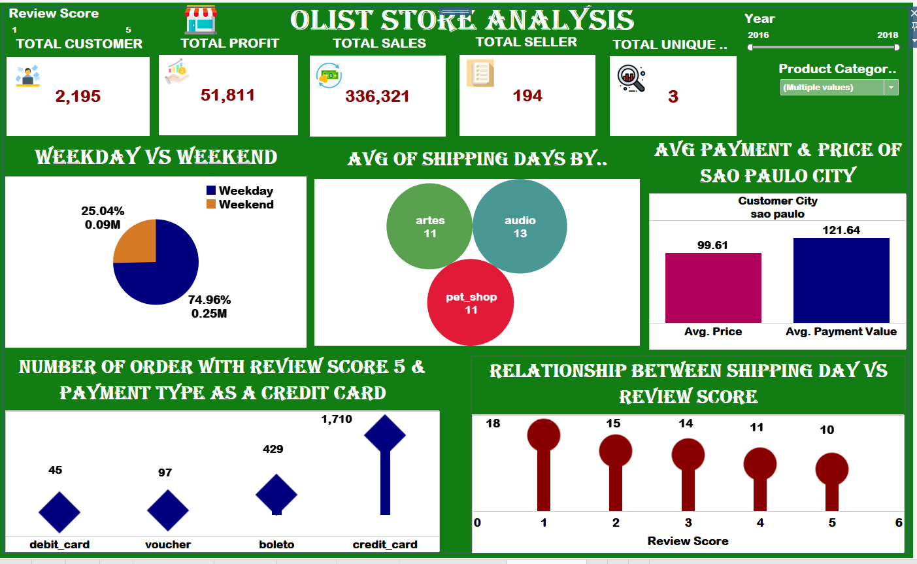
Olist Tableau dashboard

Slide 11
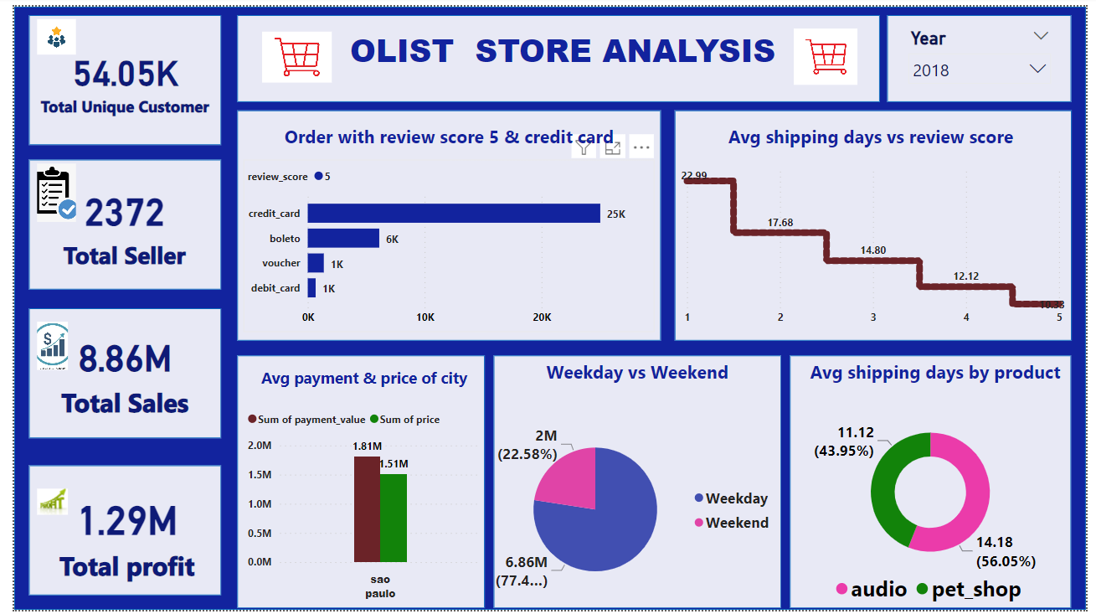
Olist Power dashboard

Slide 12
insights
According to the data, Olist E-commerce has about 99,440 orders with about 89,940 orders being delivered, the company has a 90% delivery success rate. Their average product rating is 4.09 stars, with product categories going as high as 4.67 stars and as low as 2.5 stars. 1 stars review are on third place in the review score distribution ranking which likely indicates that there could be problems with product quality in some product categories. Delivery performance could also influence review scores and success rate could certainly be improved.
Insights from this analysis can help in making business decisions, such as focusing on products that customers are interested in improving product and service quality and optimizing marketing in provinces with high total sales.in addition, this analysis also provides an overview of customer consumption trends and pattern that can be used to direct further business strategies.

Slide 13
recommendations
Regularly monitor and analysis customer reviews to gain insights in product quality and identify areas for improvement. Dashboards can be used to identify patterns in customer reviews. This will provide a data-driven approach to enhance customer experience.
Investigate delivery delays and undelivered orders. Analysing geographic locations could bring insights about certain challenges with demographics, accessibility and possible route optimization. Tracking fleet performance with the use of telematics can help identify issues before they become a problem.
Providing a proper shipment tracking system aids in having clear and concise communication between customers, seller and couriers. Regular updates can proper expectations among customers and specific delivery instructions of customers can be properly accommodated. By establishing trust and communication both parties can work together to resolve any issues that may arise.

Slide 14
conclusion
The Olist Store Analysis project provides valuable insights into customer behaviour and payment statistics. The analysis of these KPIs helps Olist in identifying areas of improvement and creating targeted marketing campaigns. As a data analyst, I have used Excel and Power BI to clean and manipulate the dataset and create meaningful visualizations. This project serves as a great example of how data analysis can help businesses make informed decisions.

